Slide 1
VMIS · SYSTEM DOCUMENTATION
Process Flow: Login to Audit
How a session moves through the Vehicle Management Information System — from a badge-number login, through the role-gated modules where records get created and changed, down into the activity log that captures all of it, and back out through the one role allowed to review it.
01
02
03
ACCESS
WORKSPACE
AUDIT

Slide 2
Three Stages, One Audit Trail
Every session takes the same path — the role only changes how much of the workspace it can see.
01
Access & Authentication
A badge number or e-mail plus password. A session is created immediately, but is held at a forced password-change screen until is_password_changed flips to 1 — and every failed attempt is written to the log with a reason, not just “failed.”
02
Role-Gated Workspace
The Dashboard and five modules — Vehicle Inventory, Maintenance & PMS, Driver Management, Vehicle Types, System Users. Every query is filtered by role before it runs, so a Station Administrator's screen never even fetches another station's rows.
03
Audit Trail & Oversight
Every create, update and delete — plus every login, logout and failed login — funnels into one Activity Log. Only a user whose role is SUPER ADMINISTRATOR can open it; everyone else gets a 403 and never sees the nav item.

Slide 3
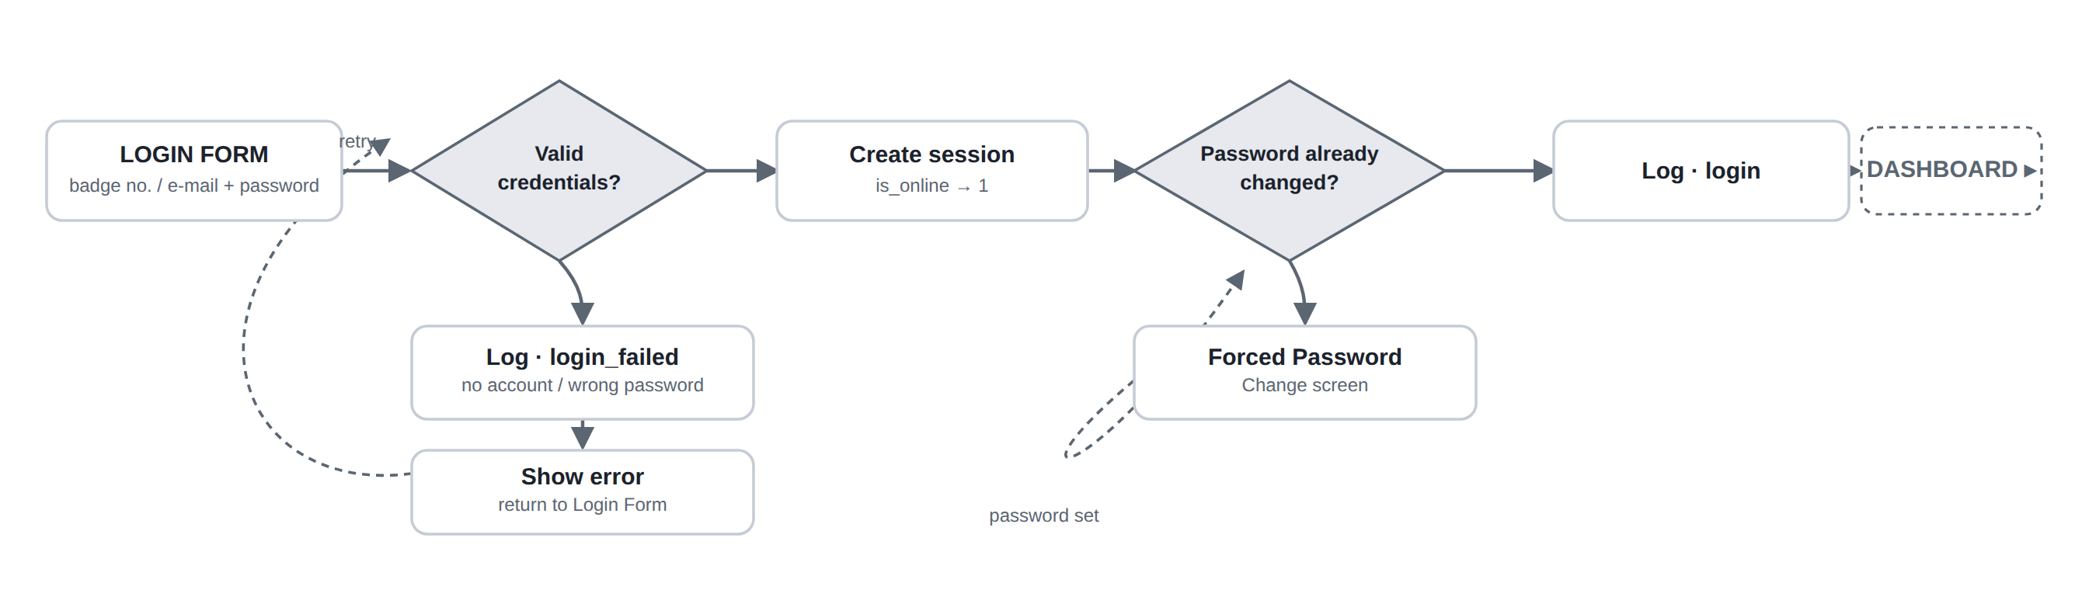
01 · ACCESS & AUTHENTICATION
From credentials to a logged-in session
A session is created the moment credentials check out — but redirectAfterAuth() withholds the dashboard, and the “login” log entry, until the password has been changed at least once.

Slide 4
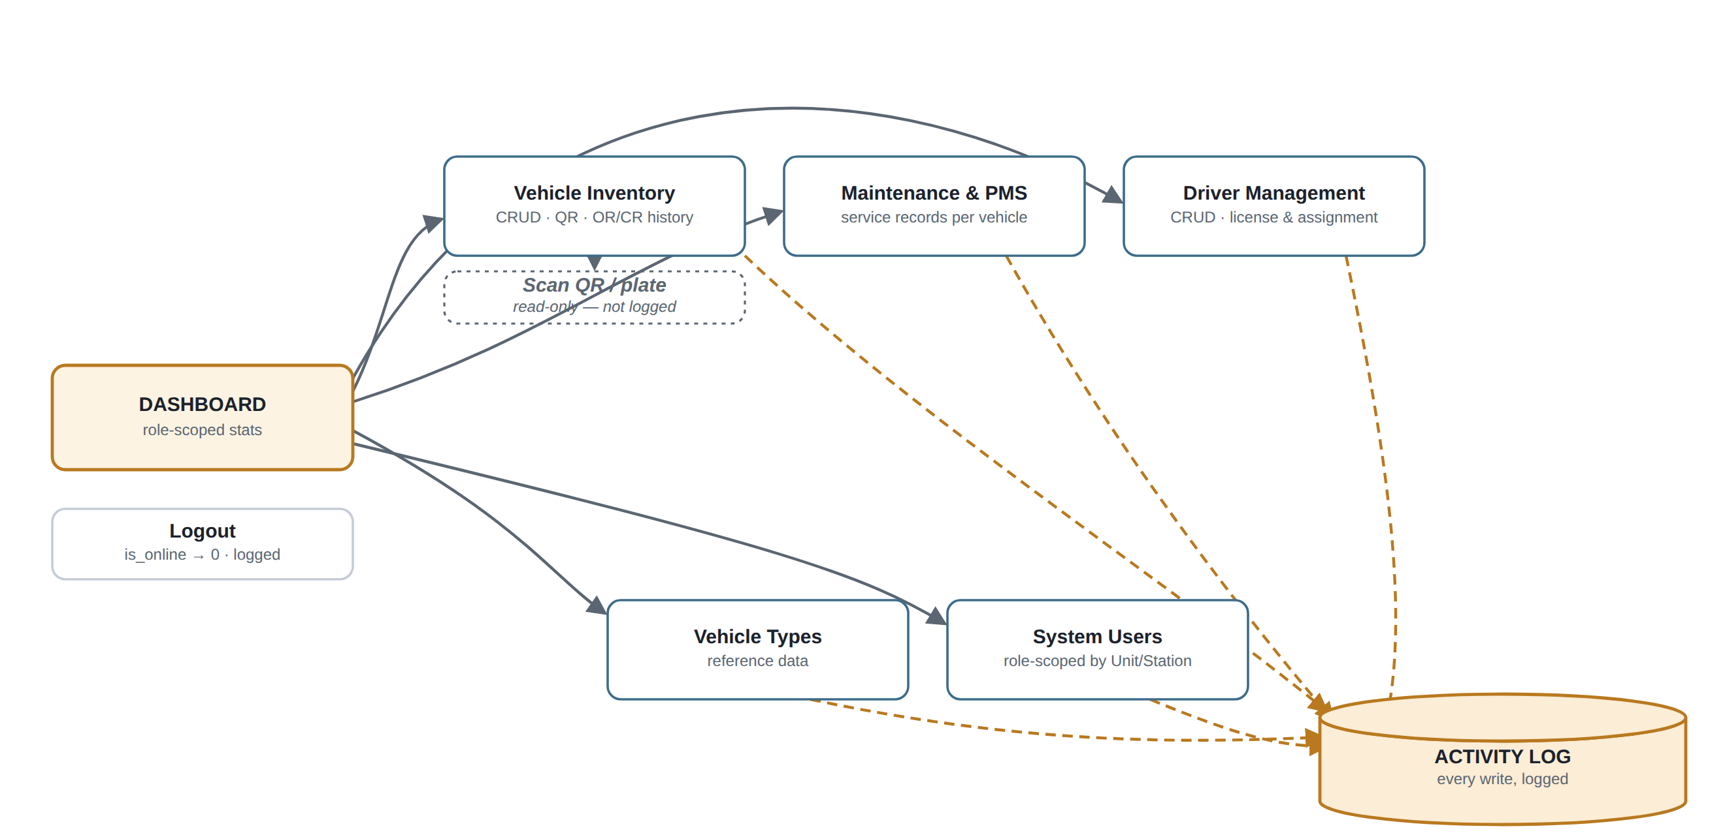
02 · ROLE-GATED WORKSPACE
Five modules, one shared audit thread
Scan QR / plate is the one exception: a read-only lookup against Vehicle Inventory data, so it never touches the Activity Log.

Slide 5
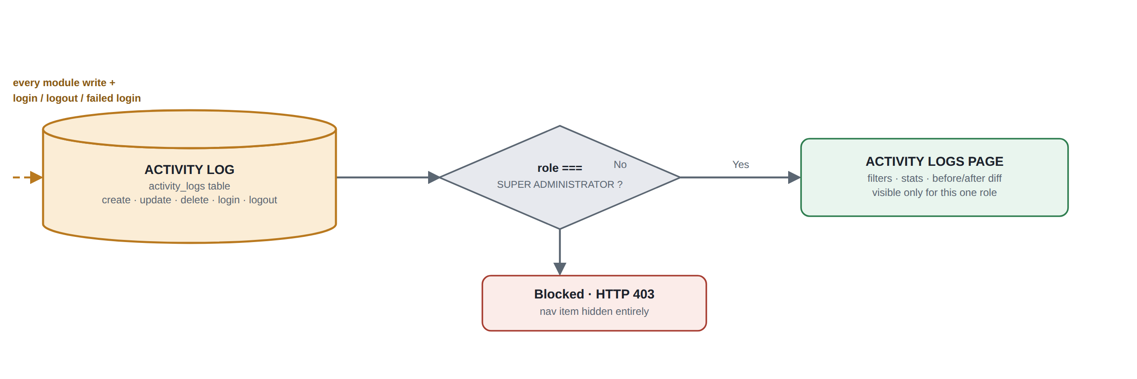
03 · AUDIT TRAIL & OVERSIGHT
Reviewing what the log has captured
The role check happens on every request to the Activity Logs page — not just once at login — so a demoted account loses access immediately.

Slide 6
Rules Worth Remembering
01
Role scope narrows automatically
The Dashboard and every module query is filtered by the signed-in role before it runs. A Unit Administrator sees their unit and every station beneath it; a Station Administrator sees only their own station — the query itself never fetches out-of-scope rows.
02
The password gate can't be skipped
A session exists the moment credentials check out, but it is refused anywhere except the forced password-change screen until is_password_changed flips to 1. The dashboard, and the “login” log entry itself, only exist on the other side of that gate.
03
Logging isn't a per-page decision
Every controller calls the same ActivityLog::record() helper on write, so there's no module where an edit can slip through unlogged. Uploaded files and passwords are stripped from the payload before it's ever written.
VMIS · System Documentation

